Slide 1
Movie recommender system
Built on User Based Collaborative Filtering Methodology
Manu Kushwaha – 09/10/2016

Slide 2
Overview
Project Motivation
Dataset
Exploratory Data Analysis
Recommender Model
Results
Conclusion and Future Work

Slide 3
Project motivation
To build a movies recommender system which:
Uses the readily available public MovieLens dataset
Utilizes the “recommenderlab” R package from CRAN to build and analyze the model
Recommends top 5 movies to 10 target users based on their similarities to other users
To understand:
One of the few recommender models available in the domain of Data Science
Data wrangling methods using base-R, dplyr and other useful packages to bring dispersed and unstructured data into a correct structure and format for analysis
What the data reveals through EDA
Be knowledgeable enough to provide an intelligent feedback on the project and the required future work for improvement

Slide 4
Dataset - Movielens
The MovieLens dataset is provided by the GroupLens Research Group. (Please refer to the “READ.ME” file included in the submission for endorsements) and was downloaded from:
http://grouplens.org/datasets/movielens
The chosen dataset is from:
“MovieLens 1M Dataset” section (file name : “ml-1m.zip”)
Contains 1, 000, 209 anonymous ratings of approx. 3, 900 movies made by 6040 MovieLens users who joined in 2000
Split between 3 files:
Ratings
Users
Movies

Slide 5
Dataset – movielens, cont..
Ratings File description:
Structure:
UserID::MovieID::Rating::Timestamp
Content:
UserIDs range between 1 and 6040
MovieIDs range between 1 and 3952
Ratings are made on a 5-star scale (whole-star ratings only)
Timestamp is represented in seconds since the epoch as returned by time(2)
Each user has at least 20 ratings

Slide 6
Dataset – movielens, cont..
Users File description:
Structure:
UserID::Gender::Age::Occupation::Zip-code
Content:
Gender is denoted by a “M” for male and “F” for female
Age is chosen from the following ranges and is only denoted by the keys:
1: “Under 18”, 18: “18-24”, 25: “25-34”, 35: “35-44”, 45: “45-49”, 50: “50-55”, 56: “56+”
Occupation is chosen from the following choices and is also only denoted by the keys:
0: “other” or not specified, 1: “academic/educator”, 2: “artist”, 3: “clerical/admin”, 4: “college/grad student”, 5: “customer service”, 6: “doctor/health care”, 7: “executive/managerial”, 8: “farmer”, 9: “homemaker”, 10: “K-12 student”, 11: “lawyer”, 12: “programmer”, 13: “retired”, 14: “sales/marketing”, 15: “scientist”, 16: “self-employed”, 17: “technician/engineer”, 18: “tradesman/craftsman”, 19: “unemployed”, 20: “writer”

Slide 7
Dataset – movielens, cont..
Movie File description:
Structure:
MovieID::Title::Genres
Content:
Titles are identical to titles provided by the IMDB (including year of release)
Genres are pipe-separated and are selected from the following 18 genres:
Action, Adventure, Animation, Children’s, Comedy, Crime, Documentary, Drama, Fantasy, Film-Noir, Horror, Musical, Mystery, Romance, Sci-Fi, Thriller, War, Wester

Slide 8
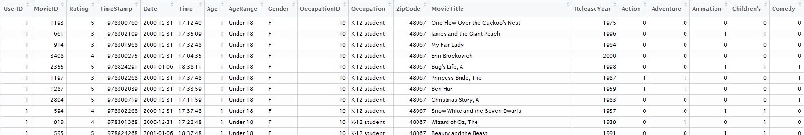
Exploratory data analysis
The data in the 3 files was combined into a correct structure and format to get to the following full movie dataset table:
Movies and Genres are related using a binary classification (as shown)
The idea is to understand the data in terms of: trends, distributions and whether any insights can be gained into user behaviors
Note: For the purpose of this project and the recommender model, not all the data presented here will be used

Slide 9
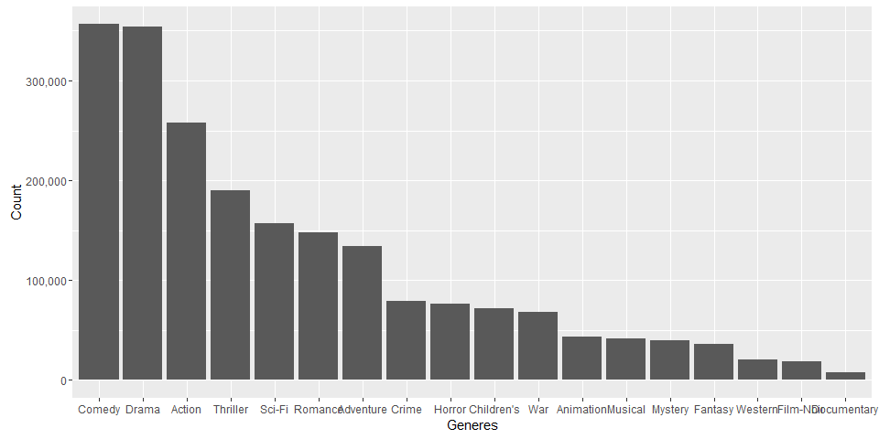
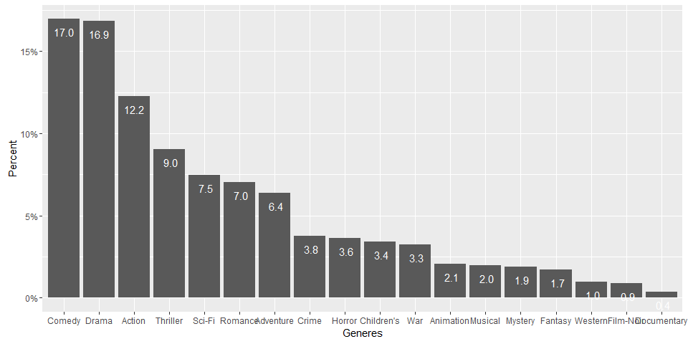
Exploratory data analysis, cont..
Data distribution:
The dataset shows:
Right skewed distribution
Comedy and Drama genres make up a approx. 35% of the data, followed by Action and Thriller
Other genres appear grouped with similar number of occurrences in the dataset (i.e. Scifi, Romance and Adventure seem to have between 5%-7% share each, Crime, Horror, Children’s and War seem to be between 2.5%-3.5%, and so forth)
Observational Comments:
Since each user is required to rate at least 20 movies, it appears that there is a bias towards the first 5 – 7 genres

Slide 10
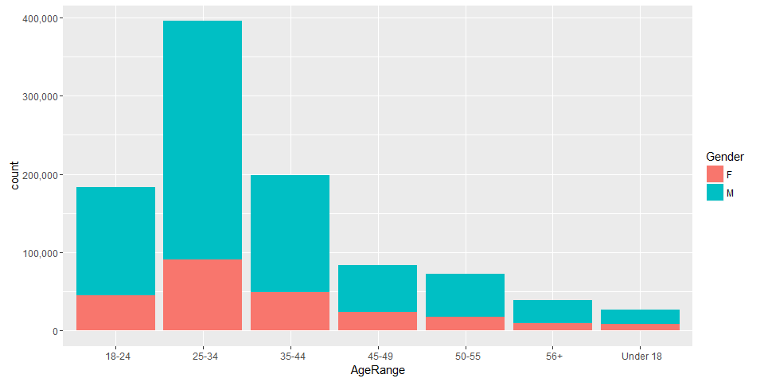
Exploratory data analysis, cont..
Gender vs. Age distribution:
The dataset shows:
Significantly larger portion of male users than female users
Age range from 18 to 44 makes up the most of the watched movies in the dataset, with 25-34 years of age leading the group
Observational Comments:
It would make sense as this is the age group where most of us are working in full swing and perhaps carving paths for raising families
As the users grow older, the number of movies watched decreases significantly; again, a not so surprising fact, that people would be busy enjoying time performing other activities

Slide 11
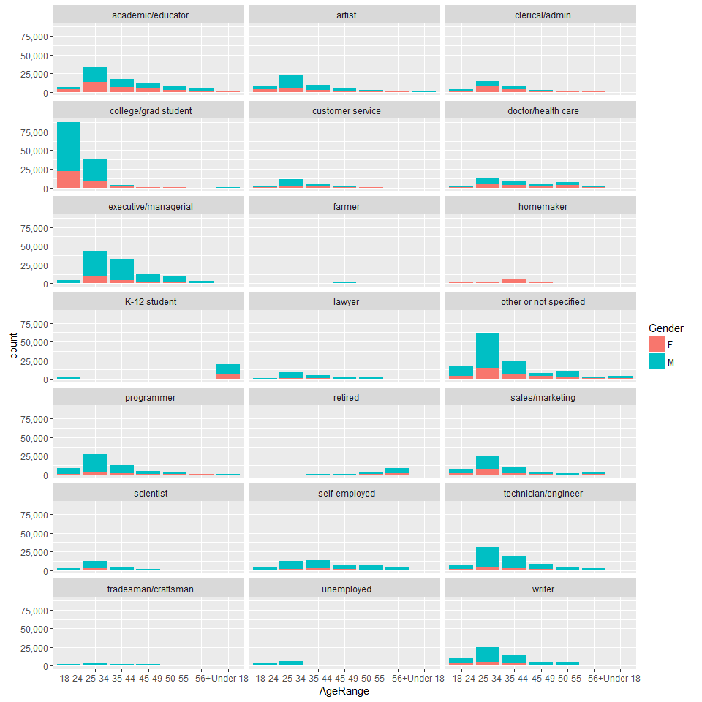
Exploratory data analysis, cont..
Occupation, Gender and Age distribution:
The dataset shows:
Few occupations stand out where quite a lot of movies have been watched
A large number of them fall under college/grad student occupation
Other or not specified, executive/managerial, technician/engineer follow while the rest are relatively small in proportion
Popular age groups obtained earlier seem to hold
Observational Comments:
It makes sense that 18-24 is the range where most people go to college
The gender distribution does not change from before either

Slide 12
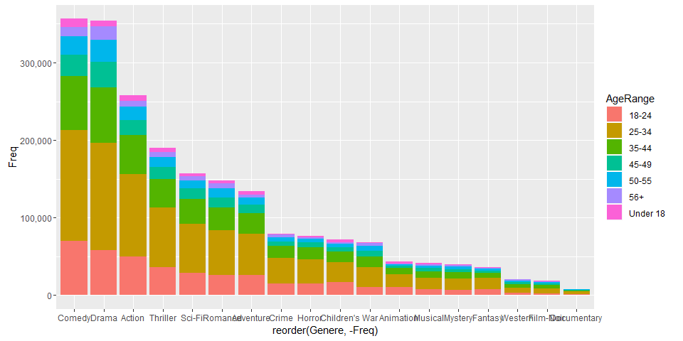
Exploratory data analysis, cont..
Age vs Genre Trends:
The dataset shows:
25-34 age range makes up the largest chunk of the distribution across all the genres
Observational Comments:
Again, this age group is very active in watching movies and prefers the top 5 -7 genres, or conversely,
Majority of the dataset comprises users who fall in this age range category (already stated) and hence the bias

Slide 13
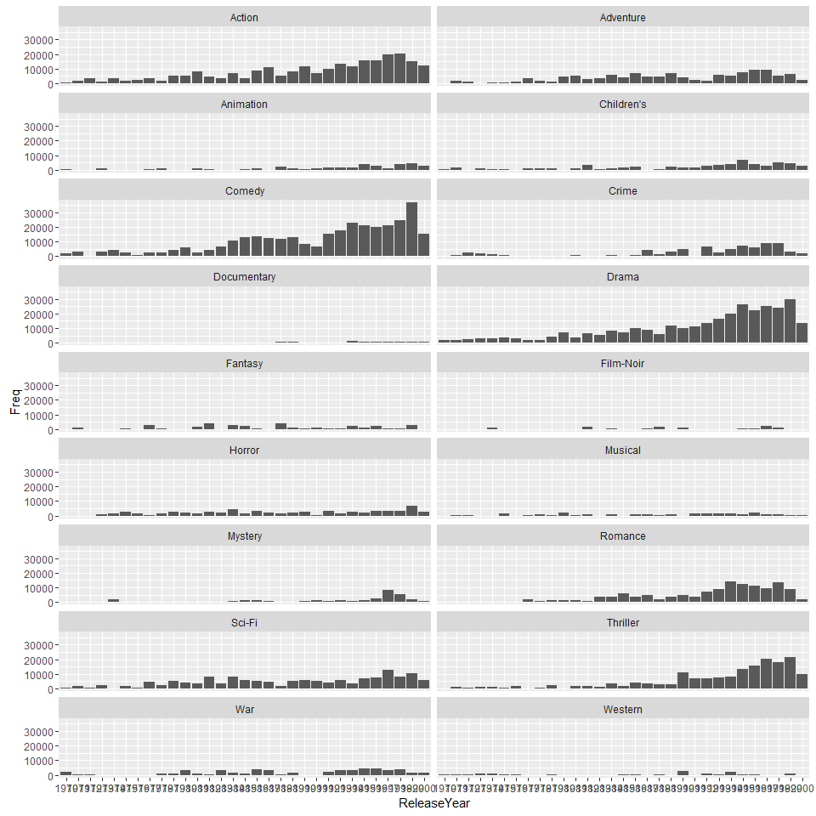
Exploratory data analysis, cont..
Genre vs Release Year Trends:
The dataset shows:
Drama, Comedy, Action, Scifi, Thriller and Romance genres gained in popularity over time
The rest of the genres did not exhibit this level of increase
Observational Comments:
The data is shown from 1970 onwards as there is no sensible data available between 1919 and 1970
These are the same genres that make up the largest percentage of the dataset

Slide 14
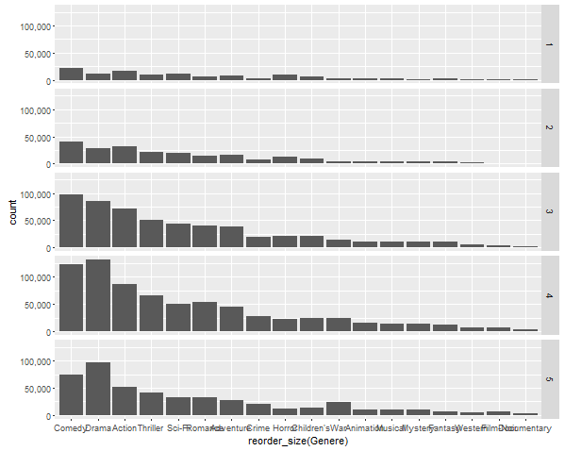
Exploratory data analysis, cont..
Genre vs Rating Distribution:
The dataset shows:
Popular ratings occur between 3 and 5, followed by 2 and 1, respectively
Observational Comments:
Users prefer to rate movies between 3 and 5
The dataset has a large portion of movies with the popular genres that fall in the 3 – 5 rating category (dataset bias)

Slide 15
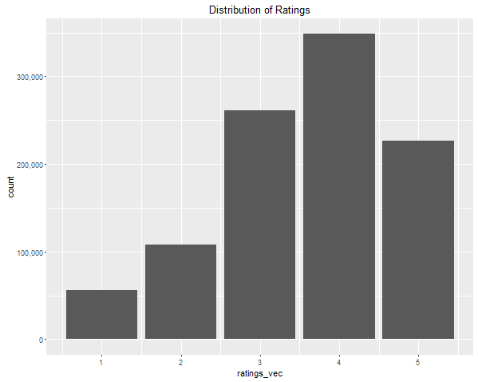
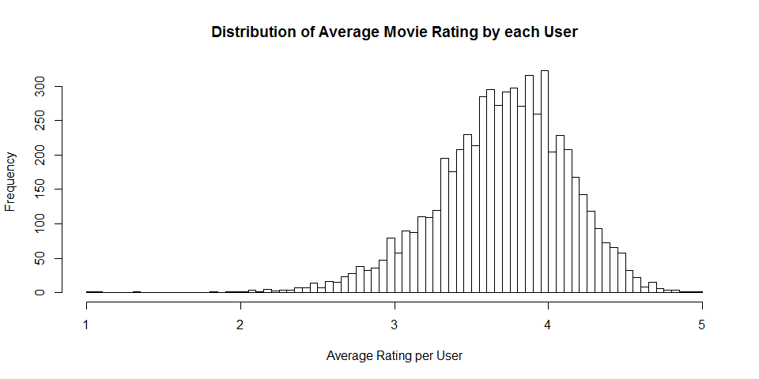
Exploratory data analysis, cont..
Ratings data distribution:
The dataset shows:
Users might be more biased towards giving ratings between 3 and 5 and not so inclined towards a rating of 1
Observational Comments:
Again, majority of the users have a tendency to rate between 2.5⁺ - 3 and 4 - 4.5⁺, with steep decline when rating 5.
The range from 1 to 2.5 is the lowest, perhaps implying that users may only prefer to watch movies that are rated 3 and above

Slide 16
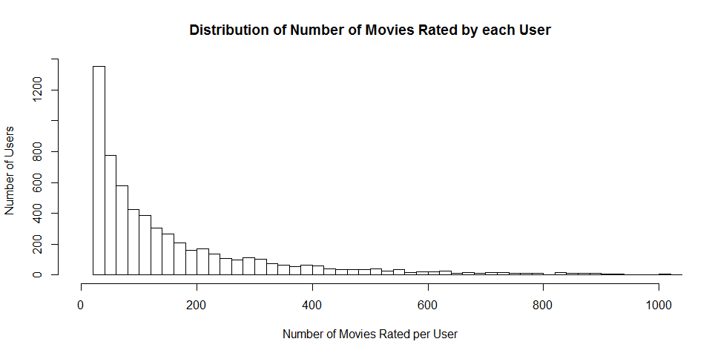
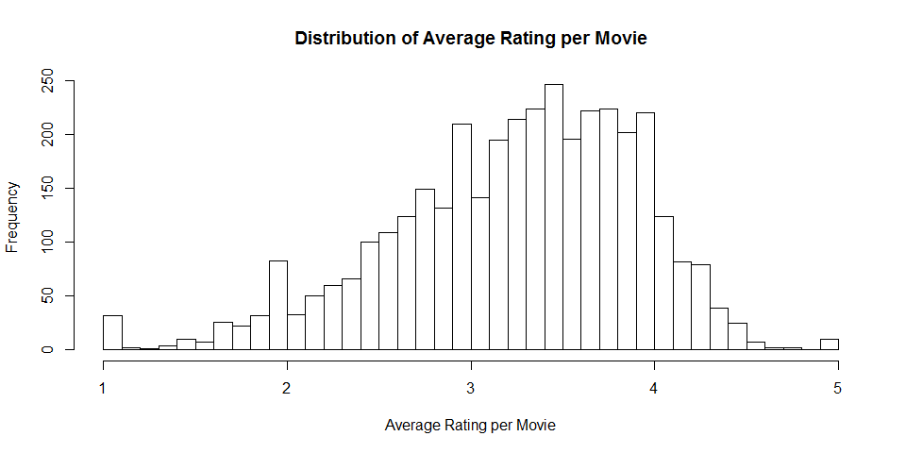
Exploratory data analysis, cont..
Movies rating data distribution:
The dataset shows:
Most users lie in the region where they have rated at least 20 movies (known fact from the MovieLens dataset)
As the number of movies increase, the users count falls
Again, the average rating per movie reaffirms the 2.5+ to 4.5+ range

Slide 17
Exploratory data analysis, cont..
Concluding Remarks:
Out of the 18 Genres available:
Only about 5-7 of them are of significance and make up 76% of the entire dataset
These have gained in popularity over years (i.e. more of these genres were released after 1970).
Releases from 1919 to 1969 are not at all significant
Users in the age range from 18 to 44 are the ones who watch the most movies
Gender distribution is not significant
Out of the 21 occupations, only about 4 occupations stand out with another 4 at the next level
Finally, a large portion of movies fall between the ratings of 3, 4 and 5, (i.e. from 2.5⁺ to 4.5⁺) and these also happen to be for the significant genres identified earlier

Slide 18
Recommender model
The “recommenderlab” package in R is used to build the User Based Collaborative Filtering model (UBCF)
The approach taken is as follows:
Select the UserID, MovieID and Rating columns from the full movie dataset
Convert it into the “realRatingMatrix” with:
Columns representing the items (MovieIDs)
Rows representing the users (UserIDs)
Ratings which fill the matrix
Select only the first 1000 users (due to expensive computation) and use the:
“UBCF” method to recommend top 5 movies to the next 10 users not in the 1000 user dataset
Finally, validate the “UBCF” model using 90% of the 1000 user dataset as train and 10% as test sets and determine the errors in predictions

Slide 19
Recommender model, cont..
The idea behind the “UBCF” model is to:
Look at the rating similarities between a group of users (X) on items they have rated and make predictions/recommendations to target users (Y) who are deemed similar to (X)
The assumption is that users with similar preferences will rate items similarly
The method used to determine similarities is the popular “Cosine” similarity function

Slide 20
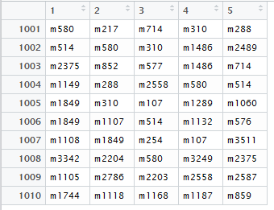

results
The table below shows the top 5 movie predictions for the 10 target users
Where:
Rows are the UserIDs
Columns are the top 5 rankings going from 1 (being the best) to 5
MovieIDs (prefixed with “m”) which fill the matrix
The error in prediction shown below is relatively low for the UBCF model

Slide 21
Conclusion and future work
The UBCF model was successfully built using the “recommenderlab” package
Top 5 movie recommendations were made to 10 target users based on a model trained using 900 users out of a total1000
There is a significant scope open for future work, in that:
Conduct an even deeper EDA on the ratings data to find most relevant users and items
Implement the conclusions obtained after the EDA to increase the relevance of the dataset
Conduct an Item Based Collaborative Filtering as well to see how similar items are ranked
Create a genre based user movie rating matrix to better understand how a user would rate genres and then re-run the UBCF and IBCF models
Perhaps, use Principal Component Analysis to create a better feature set on the full movies dataset created in the project and then run the models again

